Slide 1

Movie Revenue Prediction
Phani Abhiram Raju - 02073172
Jeevan Ravi Kumar - 02009594
Notes:
To change the image on this slide, select the picture and delete it. Then click the Pictures icon in the placeholder to insert your own image.

Slide 2
Introduction
Importance of predicting movie revenues in the film industry.
Overview of challenges in forecasting box office success.
Role of data science and machine learning in revenue prediction.
Notes:
The film industry operates on predictions and forecasts. Knowing how well a movie might perform can significantly influence production and marketing decisions. Our project focuses on using machine learning techniques to predict movie revenues, offering a tool that can help in decision-making processes within this dynamic industry.

Slide 3
Project Objective
To develop a predictive model for estimating movie revenues.
Aid stakeholders in decision-making and investment planning.
Compare the efficacy of different ML models in this context.
Notes:
“The main objective of our project was to develop an accurate and reliable machine learning model to predict movie revenues. This tool is intended to help producers, investors, and marketers make more informed decisions by providing insights into potential financial outcomes before a movie's release.”

Slide 4
Business Objectives and Constraints
Objectives: Accurate forecasting, strategic planning, risk reduction.
Constraints: Data quality and availability, industry volatility, privacy and ethical considerations.
Notes:
Our work was driven by two main goals: accuracy in prediction and practical applicability in the film industry. However, we faced several constraints, including the need for high-quality, comprehensive data, the challenge of modeling the unpredictable nature of movie success, and ensuring that our model adheres to ethical data practices."

Slide 5
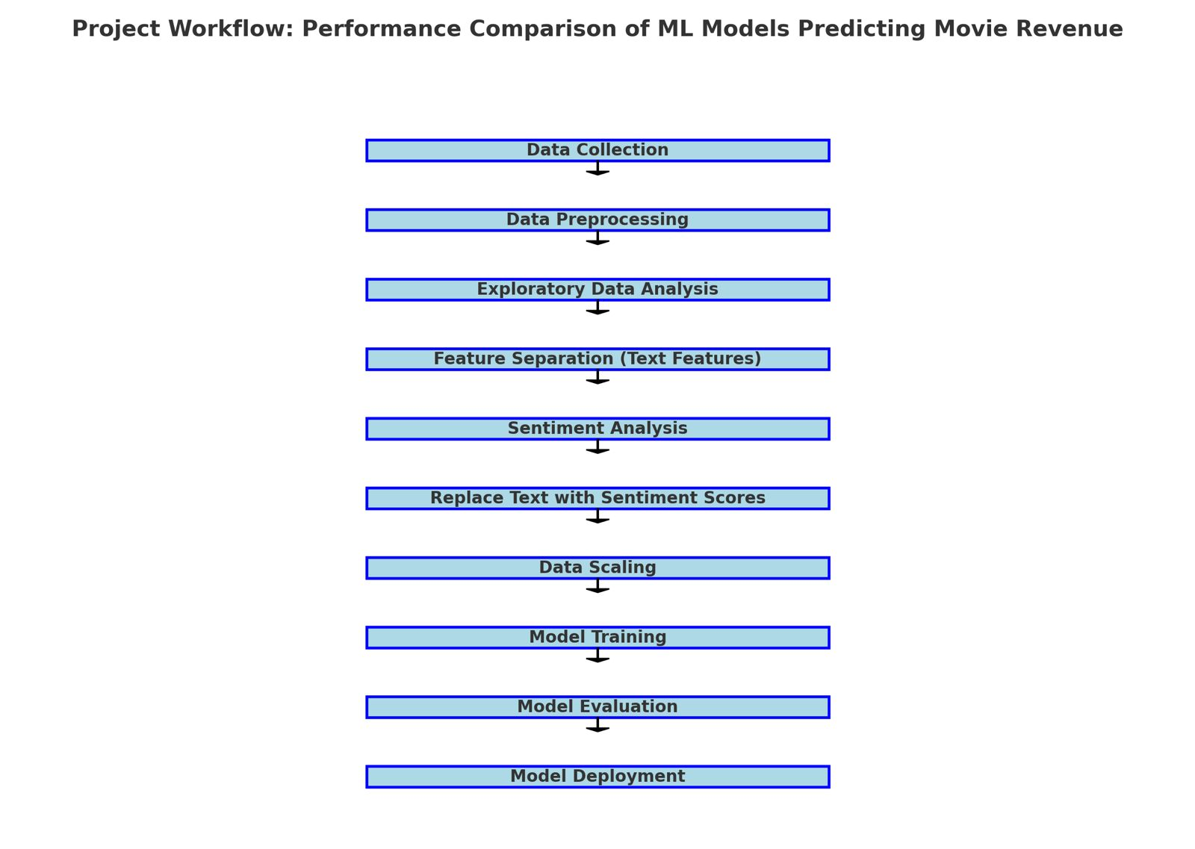
Project Workflow
Notes:
Our work was driven by two main goals: accuracy in prediction and practical applicability in the film industry. However, we faced several constraints, including the need for high-quality, comprehensive data, the challenge of modeling the unpredictable nature of movie success, and ensuring that our model adheres to ethical data practices."

Slide 6
Dataset Overview
Source: TMDB 5000 dataset from The Movie Database.
Key features: Budget, genre, production details, release dates, runtime, cast, crew.
Data volume and diversity (genres, production houses).
Notes:
We used the TMDB 5000 dataset, which is a rich compilation of movie data. This dataset provided us with a variety of features, including budget, genres, production details, release dates, and runtimes. Such diverse data allowed us to build a more nuanced model that can account for the many factors influencing movie revenue."

Slide 7
Exploratory Data Analysis
Analysis of budget-revenue correlation.
Trends in movie genres and their profitability.
Visualization of production trends over years.
Notes:
In our exploratory data analysis, we delved deep into the dataset to understand underlying patterns and correlations. We looked at how different factors like budget, genre, and release timing relate to revenue. These insights helped us in feature selection and model tuning later on.”

Slide 8
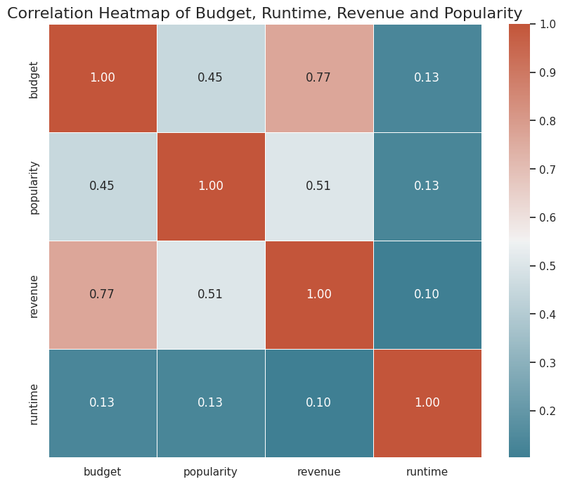
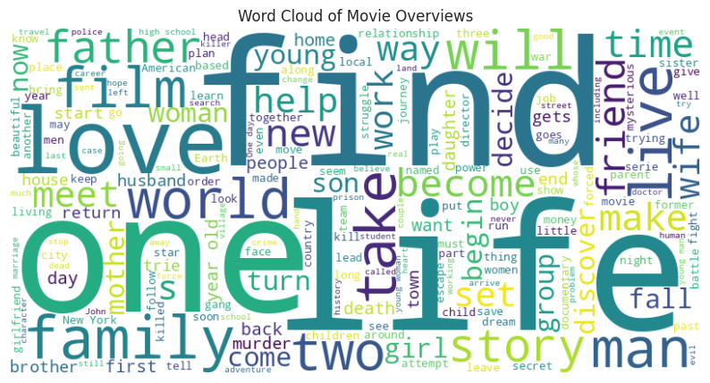
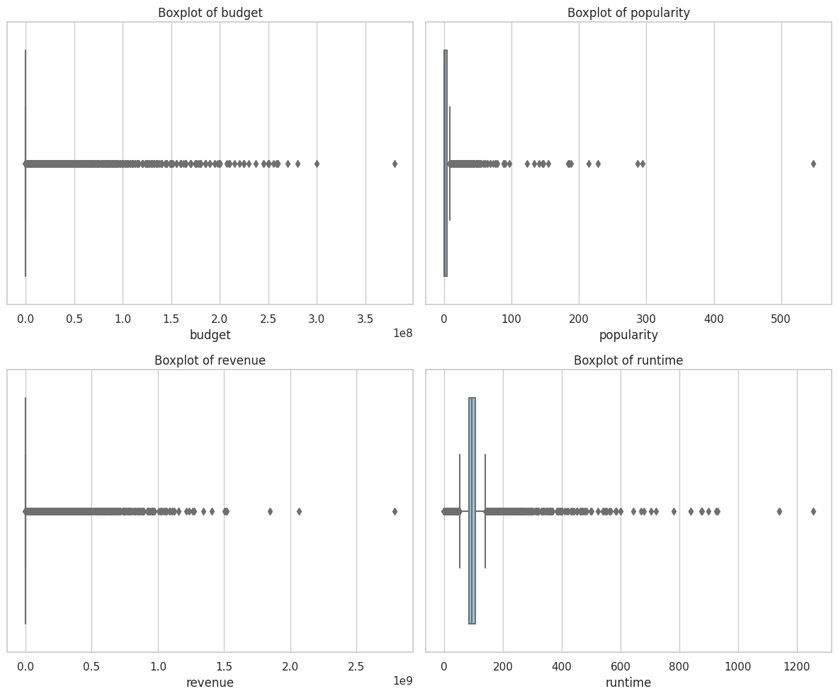
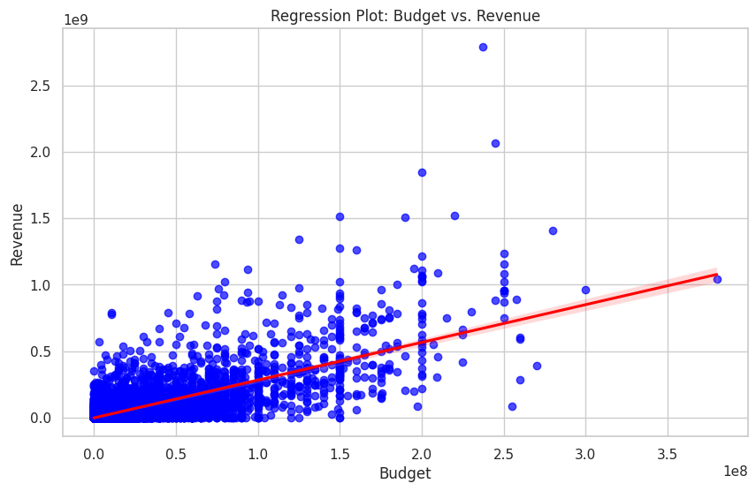
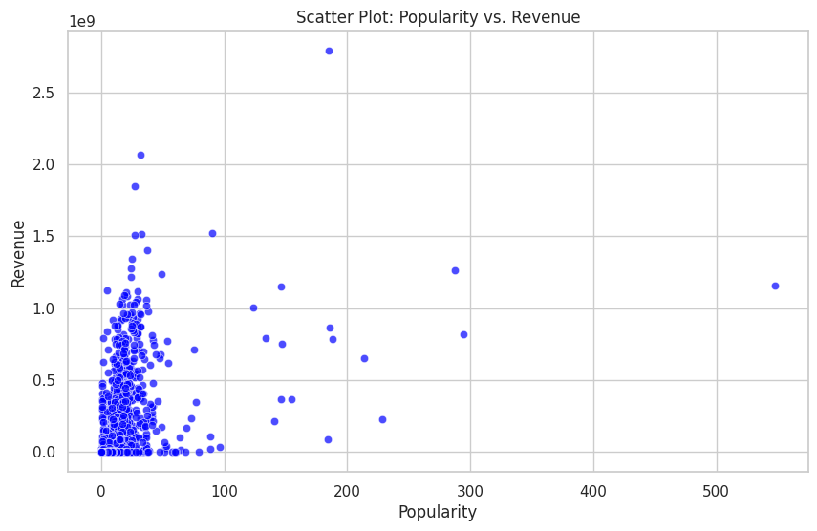
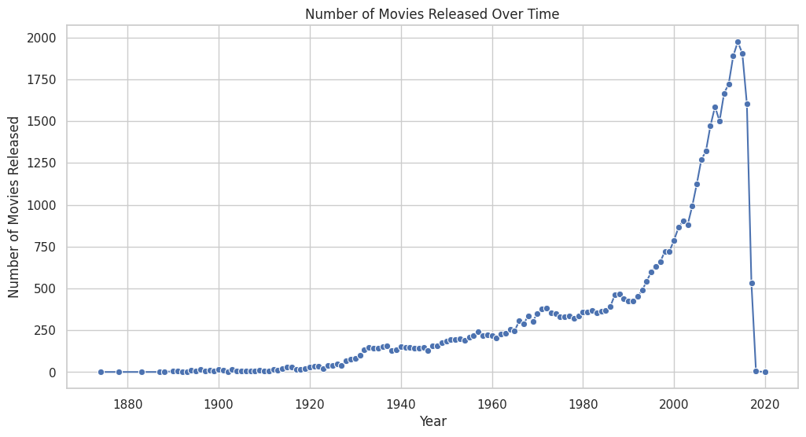
Exploratory Data Analysis

Slide 9
Data Preparation
Data cleaning: Duplicate removal, handling missing values.
Feature engineering: Numeric conversions, sentiment analysis from plot descriptions.
Data normalization techniques used.
Notes:
Preparing the data was a critical step. We cleaned the data to ensure accuracy, handling duplicates and missing values. Additionally, we transformed certain features, such as converting text data into numerical values through sentiment analysis, to make them usable for our machine learning models.

Slide 10
Model Selection
Linear Regression: Basics and rationale for selection.
Random Forest Regressor: Overview and suitability for the project.
Criteria for model comparison: Accuracy, scalability, interpretability.
Notes:
We selected Linear Regression and Random Forest Regressor for our analysis. Linear Regression helped us understand basic trends, while Random Forest, a more complex model, allowed for deeper insights due to its ability to handle non-linear relationships and interactions between features.”

Slide 11
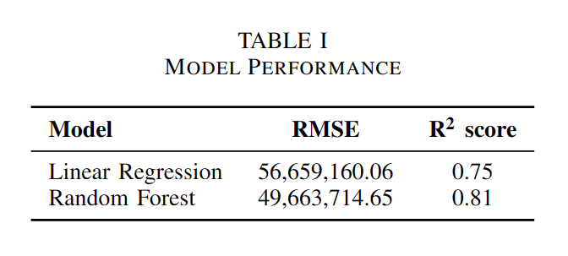
Model Performance
Performance metrics: RMSE (Root Mean Square Error) and R2 score.
Comparative analysis: Linear Regression vs Random Forest.
Notes:
Our evaluation focused on comparing the models based on Root Mean Square Error and R2 score. The Random Forest model showed a clear advantage, offering higher accuracy and better handling of diverse data, as depicted in these results.”

Slide 12
Model Deployment
Selection of Random Forest for superior performance.
Process of model pickling for deployment.
FastAPI web application: Features and user interface.
Notes:
After model selection, we deployed the Random Forest model into a practical application. We developed a FastAPI-based web application, where users can input movie-specific data and receive instant revenue predictions, demonstrating the model’s practical utility."

Slide 13
Conclusion
Recap of the project's success in achieving its objectives.
The potential impact of the model on the film industry.
Future directions and possible enhancements.
Notes:
“To conclude, our project not only achieved its goal of predicting movie revenues but also demonstrated the applicability of machine learning in real-world scenarios. While there's room for further refinement, the current model stands as a significant step towards data-driven decision-making in the film industry."

Slide 14
Thank You
Notes:
“To conclude, our project not only achieved its goal of predicting movie revenues but also demonstrated the applicability of machine learning in real-world scenarios. While there's room for further refinement, the current model stands as a significant step towards data-driven decision-making in the film industry."

